Slide 1

Elementary Programming (2)
University of Human Development College of Science and Technology Department of IT
Lecture :Programming
Lecturer: Tara Qadr
1st stage 2015-2016

Slide 2
Objectives
To represent a string using the String type.
To study some string methodes.
To study some To distinguish syntax errors, runtime errors, and logic error.
To show message using JOptionPane message dialog.
To obtain input using the JOptionPane input dialog boxes.
To obtain input from the console.
To know about type conversions.

Slide 3
The String Type
The String type is not a primitive type, It is known as a reference type.
The char type only represents one character.
To represent a string of characters, use the data type called String.
Example: String message = "Welcome to Java";
String is a predefined class in the Java library just like the System class.

Slide 4
How to create String object ?
There are two ways to create String object :
By string literal
By new keyword

Slide 5
1)String literal :
String literal is created by double quote.
For Example: String s = "Hello";
In this case, "Hello" is a string literal a series of characters in your code that is enclosed in double quotes.
For example:
String s1="Welcome“
String s2=“this is java code";

Slide 6
2) By new keyword:
As with any other object, you can create String objects by using the new keyword and a constructor.
String s = new String("Welcome"); //creates two objects and one reference variable
Example to Create String :
class Simple{
public static void main(String args[]){
String s= "Slaw";
String c = new String("Kurdistan");
System.out.println(s + " " + c);
}
}

Slide 7
String conctnation
1- // Three strings are concatenated
String message = "Welcome " + "to " + "Java" // message becomes Welcome to Java
2- // String Chapter is concatenated with number 2
String s = "Chapter " + 2;
// s becomes Chapter 2
3- // String Supplement is concatenated with character B
String g = “Group of " + 'B';
// g becomes Group of B

Slide 8
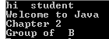
Example
class Simple1{
public static void main(String args[])
{
String s= "hi" ;
String c =new String(" student");
System .out.println(s+" "+c);
String message = "Welcome " + "to " + "Java";
System .out.println(message);
String concat = "Chapter " + 2;
System .out.println(concat);
String g = "Group of " + 'B';
System .out.println(g);
}
}

Slide 9
Length() ,charAt() equals and compareTo() methods
Length() :The length of any String variable is the total number of all characters between quotations marks including white spaces
charAt (int n) To obtain the character at the nth position
equals() : use for equality test , The result is either true or false.
compareTo() : use for comparing two strings
result is either:
= 0 if the two strings are equals
> 0 if the first string is greater than the test string
< 0 if the first string is smaller than the test string

Slide 10
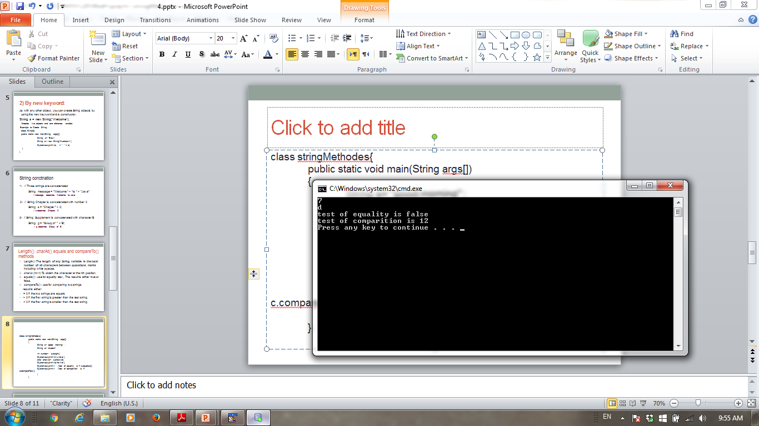
Example
class stringMethodes{
public static void main(String args[])
{
String s= "good morning" ;
String c= "student";
int number= c.length();
System.out.println(number);
char charVar= s.charAt(3);
System.out.println(charVar);
System.out.println ("test of equality is "+ s.equals(c));
System.out.println ("test of comparition is "+ c.compareTo(s));
}
}

Slide 11
Substring(), toLowerCase() and toUpperCase() methods
Substring():returns a new string that is a substring of this string. The substring begins with the character at the specified index and extends to the end of this string.
Syntax: substring ( int beginIndex)
substring ( int beginIndex , int endIndex)
toLowerCase() and toUpperCase() method converts all of the characters in a String variable respectively to lower case and Upper case.

Slide 12
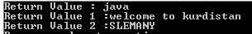
Example
public class uperAndLower{
public static void main(String args[]){
String str=" study java";
String Str1 = new String("WELCOME TO KURDISTAN");
String Str2 = new String("Slemany");
System.out.println("Return Value : " + str.substring(7) );
System.out.println("Return Value 1 :" + Str1.toLowerCase());
System.out.println("Return Value 2 :" + Str2.toUpperCase());
} }

Slide 13
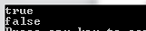
contain() method
contains() method used to search in a String variable to find if the sequence of char values exist in a String variable.
Returns true if and only if this string contains the specified sequence of char values Otherwise, return false.
Example :
Class ContainMethod{
public static void main(String args[]){
String str = "Great Kurdistan";
System.out.println ( str.contains("Kurdistan"));
boolean result = str.contains(“Slemany");
System.out.println(result);
}
}

Slide 14
Programming Errors
SyntaxErrors
Detected by the compiler
RuntimeErrors
Causes the program to abort
LogicErrors
Produces in correct result

Slide 15
Compilation Errors (1)
Errors that occur during compilation are called syntax errors.
Syntax errors result from errors in code construction.
Such as mistyping a keyword,
Omitting some necessary punctuation,
Using an opening brace without a corresponding closing brace.
Syntax errors are usually easy to detect.

Slide 16
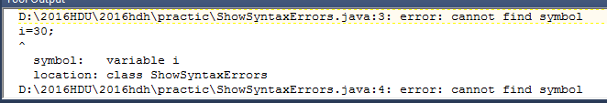
Compilation Errors (2)
public class ShowSyntaxErrors{
public static void main(String[]args){
i=30;
System.out.println(i+4);
}
}

Slide 17
Runtime Errors (1)
Runtime errors are errors that cause a program to terminate abnormally.
Runtime errors occur while an application is running if the environment detects an operation that is impossible to carry out.
Input errors are typical runtime errors.
To avoid input errors, the program may display a message like "Please enter an integer“.

Slide 18
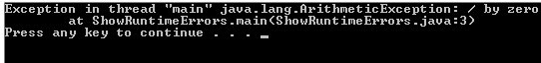
Runtime Errors (2)
public class ShowRuntimeErrors {
public static void main(String[] args) {
int i = 1 / 0;
}
}

Slide 19
Logic Errors (1)
Logic errors occur when a program does not perform the way it was intended to.
The program does not print the correct result.

Slide 20
Logic Errors (2)
For Example, the following code ...
int x; x = x + 1; System.out.println("X = " + x);
would have unpredictable results (the value of x is some random number) To fix the problem, initialize the value stored in x to a known value (like 0) ...
int x = 0; x = x + 1; System.out.println("X = " + x);

Slide 21
Displaying Message in Dialog Box
Dialog boxes are windows in which programs display important messages to users.
Class JOptionPane enable programs to display windows containing messages.

Slide 22
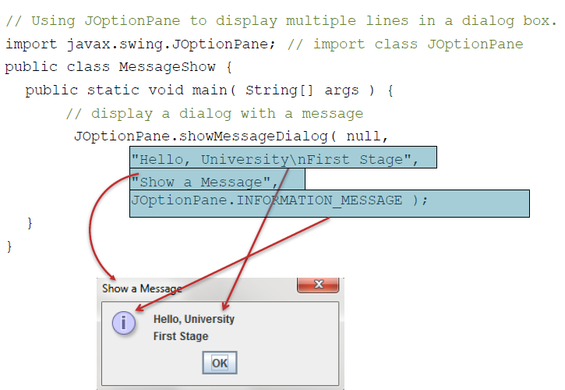
Example: Displaying Message in Dialog Box

Slide 23
Dialog Box Messages
ERROR_MESSAGE
INFORMATION_MESSAGE
WARNING_MESSAGE
QUESTION_MESSAGE
PLAIN_MESSAGE

Slide 24
Getting Input
Two ways of obtaining input:
1.Getting Input from Input Dialogs
2.Getting Input from Console.

Slide 25
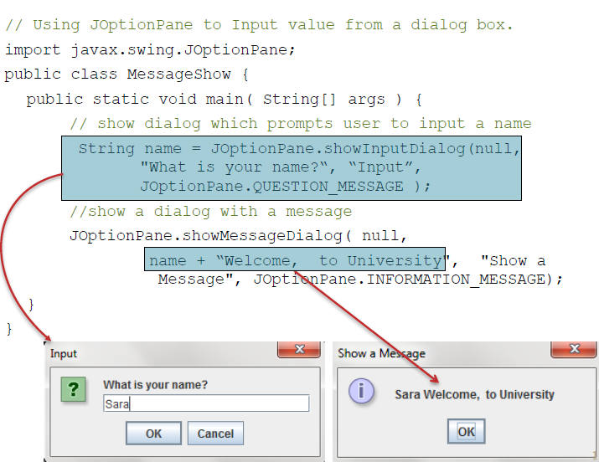
Getting Input from Input Dialog Boxes (1)

Slide 26
Getting Input from Input Dialog Boxes(2)
The input returned from the input dialog box is a string.
If you enter a numeric value such as 123, it returns “123”.
To obtain the input as a number, you have to convert a string into a number.

Slide 27
Converting Strings to Integers
To convert a string into an int value, you can use the static parseInt method in the Integer class as follows:
int value = Integer.parseInt(string);
where string is a numeric string such as “123”.

Slide 28
Converting Strings to Doubles
To convert a string into an double value, you can use the static parseDoublemethod in the Double class as follows:
double value = Double.parseDouble(string);
where string is a numeric string such as “123.5”.

Slide 29
Example: Computing Time(1)
Write a program that obtains minutes and remaining seconds from an amount of time in seconds.
For example, 500 seconds contains 8 minutes and 20 seconds.

Slide 30
Example: Computing Time (Solution Steps) (2)
The program must first ask for the seconds that the user wants to convert.
Seconds must be converted to minute by (dividing it by 60)
Since there is 60 seconds in a minute
There may be seconds remain that cannot fit into a whole minute
Take reminder of the division operation for the remaining seconds

Slide 31
Solution : Computing Time Program(3)
import javax.swing.JOptionPane;
public class DisplayTime {
public static void main(String[] args) {
int seconds = 500;
int minutes = seconds / 60;
int remainingSeconds = seconds % 60;
JOptionPane.showMessageDialog(null, seconds +
“ seconds is " + minutes + " minutes and " + remainingSeconds + " seconds");
}
}

Slide 32
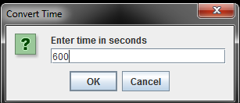
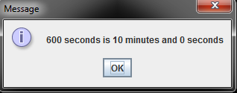
Computing Time Program (Using InputDialog) (4)
import javax.swing.JOptionPane;
public class DisplayTimeInMassage {
public static void main(String[] args) {
int seconds, minutes, remainingSeconds;
String secondStr;
secondStr = JOptionPane.showInputDialog(null, "Enter time in seconds", "Convert Time", JOptionPane.QUESTION_MESSAGE );
seconds = Integer.parseInt(secondStr);
minutes = seconds / 60;
remainingSeconds = seconds % 60;
JOptionPane.showMessageDialog(null, seconds + " seconds is " + minutes + " minutes and " + remainingSeconds + " seconds");
}
}

Slide 33
Getting Input from the Console (1)
You may obtain input:
From JOptionPane.showInputDialog method. Or,
From the console.
Java uses System.out to refer to the standard output device, and System.in to the standard input device.
You can use the Scanner class for input from console.

Slide 34
Getting Input from the Console (2)
1-import class Scanner as follows:
import java.util.Scanner;
2-Create a Scanner object
Scanner scanner= new Scanner(System.in);
3-Use the methods for reading input:
next(): reading a string. A string is delimited by spaces.
nextByte(): reading an integer of the byte type.
nextShort(): reading an integer of the short type.
nextInt(): reading an integer of the int type.
nextLong(): reading an integer of the long type.
nextFloat(): reading a number of the float type.
nextDouble(): reading a number of the double type.
Example: double d = scanner.nextDouble();

Slide 35
Reading Various Types of Data From Console
import java.util.Scanner;
public class TestScanner{
public static void main(String [] args) {
Scanner scanner = new Scanner(System.in); // Create a Scanner
System.out.print("Enter an integer: "); // Prompt the user to enter an integer
intintValue= scanner.nextInt();
System.out.println(“The integer value is " + intValue);
System.out.print("Enter a double value: "); // Prompt the user to enter a double value
double doubleValue= scanner.nextDouble();
System.out.println(“the double value is “ + doubleValue);
System.out.print("Enter a string without space: "); // Prompt the user to enter a string
String string= scanner.next();
System.out.println(“The string is " + string);
}
}

Slide 36

Example: Computing Time Program (Using console)
import java.util.Scanner;
public class DisplayTimeScanner {
public static void main(String [] args) {
int seconds, minutes, remainingSeconds;
Scanner scanner = new Scanner(System.in);
System.out.print("Enter time in seconds: ");
seconds= scanner.nextInt();
minutes = seconds / 60;
remainingSeconds = seconds % 60;
System.out.println(seconds + “ seconds is " + minutes + " minutes and " + remainingSeconds + " seconds“);
}
}

Slide 37
Numeric Type Conversion
Sometimes it is necessary to mix numeric values of different types in a computation.
You can always assign a value to a numeric variable whose type supports a larger range of values.
Example:
byte i=100;
long k=i*3+4;
Double d=i*3.1+k/2;
Int x=k; //(Wrong)
long k=x; //(fine,implicit casting)

Slide 38
Conversion Rules
Conversion of numeric types based on the following rules:
If one of the operands is double, the other is converted into double.
Otherwise, if one of the operands is float, the other is converted into float.
Otherwise, if one of the operands is long, the other is converted into long.
Otherwise, both operands are converted into int

Slide 39
Type Casting
Castingis an operation that converts a value of one data type into a value of another data type.
Two types:
Implicit: Casting a variable of a type with a small range to a variable of a type with a larger range.
Example: double d = 3; (type widening)
Explicit: Casting a variable of a type with a large range to a variable of a type with a smaller range.
Example:
int i = (int) 3.0; (type narrowing)
What is wrong ? int x = 5/2.0;

Slide 40
Casting between char and Numeric Types
Int i= 'a'; // Same as inti= (int) 'a';
char c = 97; // Same as char c = (char) 97;
Int i= '2' + '3';
Int j = 2 + 'a'; // (int)'a' is 97

Slide 41
Reference
http://docs.oracle.com/javase/tutorial/java/nutsandbolts/datatypes.html
http://www.javatpoint.com/variable-datatype
http://math.hws.edu/javanotes/c1/s4.html
INTRODUCTION TO JAVA PROGRAMMING COMPREHENSIVE VERSION 10th Edition
Paul Deitel , “Java How to Program”, 9thed.

Slide 42
THANK YOU

